Slide 1


K.RAMAKRISHNAN COLLEGE OF TECHNOLOGY
(AUTONOMOUS), TRICHY.
PARCEL TRACKING SYSTEM
PRESENTED BY
Bhavadharani A
2303811710422019
SUPERVISOR
Mr. M. Saravanan, M.E.,
AP/CSE.

Slide 2
PRESENTATION OVERVIEW
Objective
Project Introduction
Problem Statement
Methodologies (Programming concepts relevant to problem statement)
Architecture of the proposed system
List of Modules
Merits
Results and Discussion
Queries

Slide 3
OBJECTIVE
Real-Time Tracking: Enables users to track their deliveries in real time.
Parcel Status Updates: Provides status updates for admin through GPS and tracking number.
Improved Delivery Process: Enhances the delivery experience for both customers and businesses.

Slide 4
PROJECT INTRODUCTION
Parcel Management: Administrators can register parcels, assign unique tracking numbers, and update statuses like "In Transit" or "Delivered."
Real-Time Tracking: Customers can track parcels using their unique tracking numbers and view detailed status updates.
Notifications: The system sends automated alerts for key events, including dispatch, out-for-delivery, and delivery confirmation.
User-Friendly and Secure: Features include a simple interface, secure authentication, and real-time data updates for efficient and reliable usage.

Slide 5
PROBLEM STATEMENT
Challenges in Traditional Shipping:
Lack of real-time visibility of parcel status.
Inefficiencies in locating lost or delayed parcels.
Poor customer communication regarding delivery updates.
High operational costs due to manual tracking processes.

Slide 6
METHODOLOGIES
Object-Oriented Programming (OOP): Use OOP to design the system with classes like Parcel, User, and Notification for better organization.
Database Integration: Use a database to store parcel details, tracking updates, and user information securely.
Real-Time Event Handling: Update parcel statuses and send notifications immediately when key events (like dispatch or delivery) occur.
User-Friendly Design: Create a simple interface for administrators to manage parcels and customers to track them easily.

Slide 7
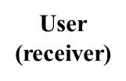
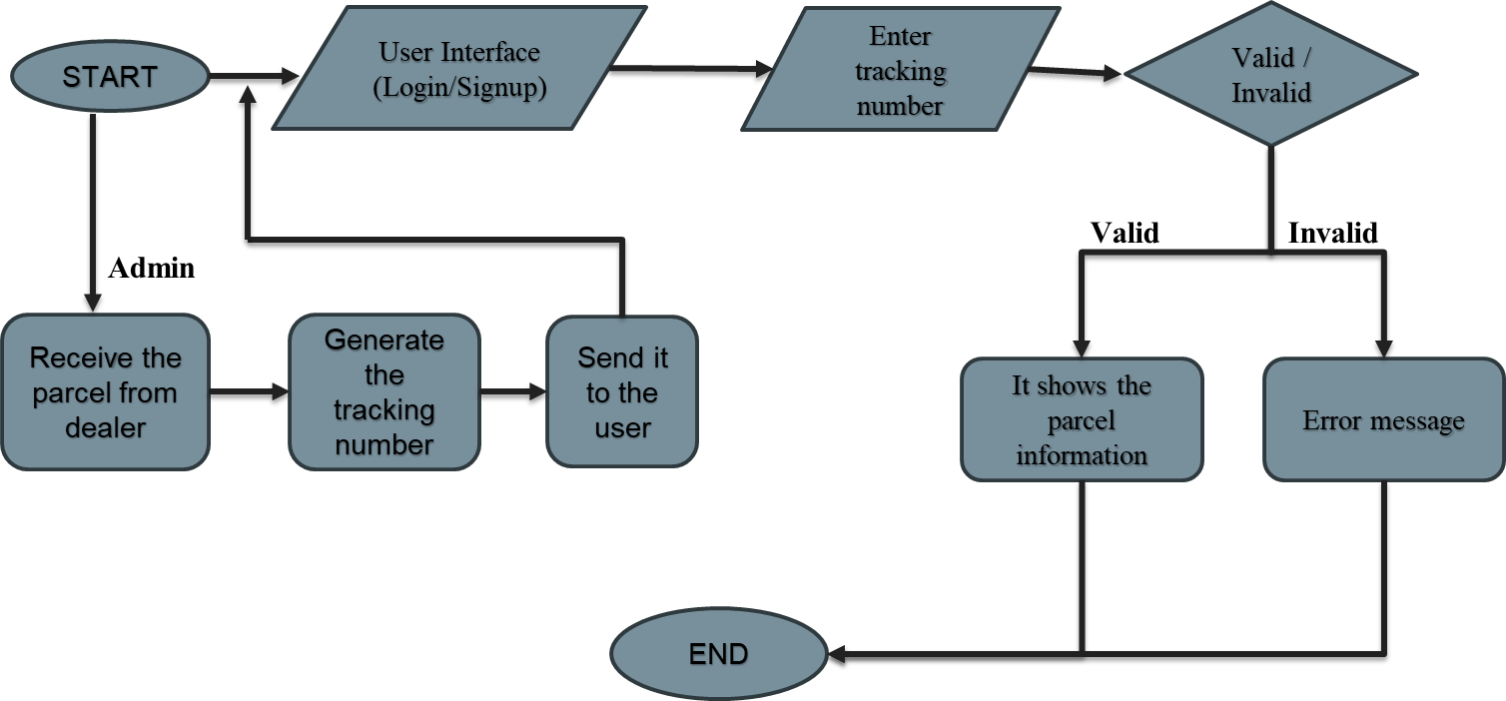
ARCHITECTURE OF THE PROPOSED SYSTEM

Slide 8
LIST OF MODULES
MODULE DESCRIPTON
Main Module
Update Module
Track Module
Data Management Module

Slide 9
MERITS
Improved Efficiency: Streamlines parcel management by automating registration, status updates, and notifications, reducing manual workload for administrators.
Enhanced Customer Experience: Provides real-time tracking and timely notifications, ensuring customers stay informed about their parcel's status.
Increased Transparency: Builds trust with users by offering detailed tracking histories and key event updates for every parcel.
Scalable and Reliable: The system is designed to handle high volumes of data with secure authentication and real-time updates, ensuring consistent performance.

Slide 10
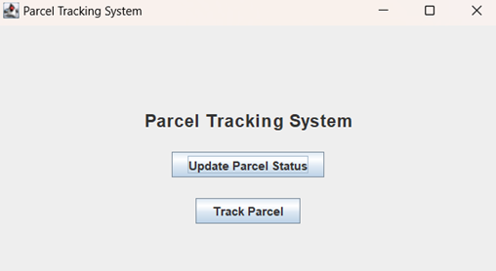
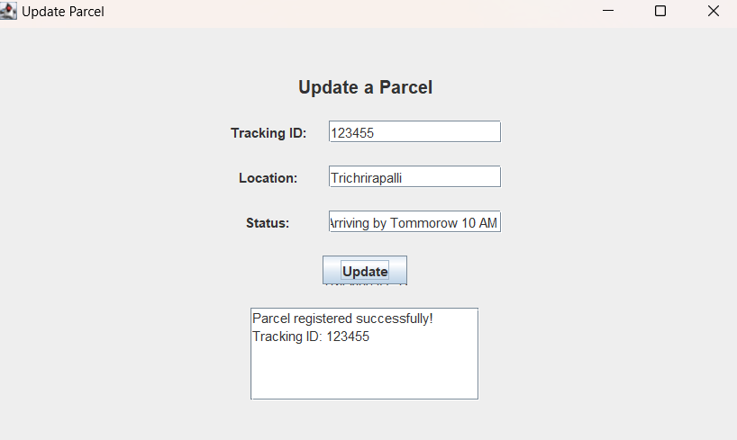
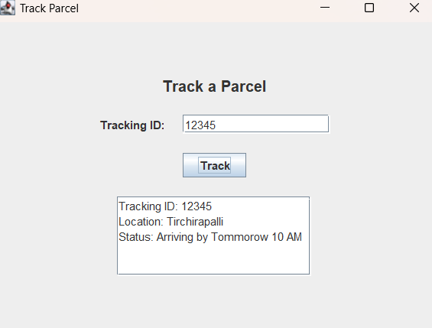
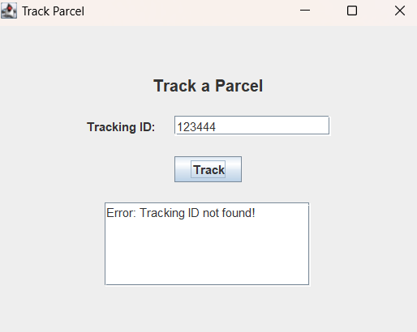
RESULTS AND DISCUSSION

Slide 11
QUERIES ?

